Slide 1
Pediculosis capitis
Justine Gonzalez, Jenny Hsu, Janelle Bogran
GNRS 583 Pediatrics, Marcia Davis
Azusa Pacific University, School of Nursing

Slide 2
Case History
A.P. is an 8-year-old who is sent to
the nurse’s office because she has had a several-day history of scratching her head so badly that she complains
that her “head hurts”.
You complete a general examination of A.P.’s head and notice that she has red, irritated areas with several scratch marks;
a few open sores; and sesame seed-sized, silvery white and yellow nodules (bugs) that are adhered to many of her hair shafts.
You determine that A.P. has pediculosis capitis.

Slide 3
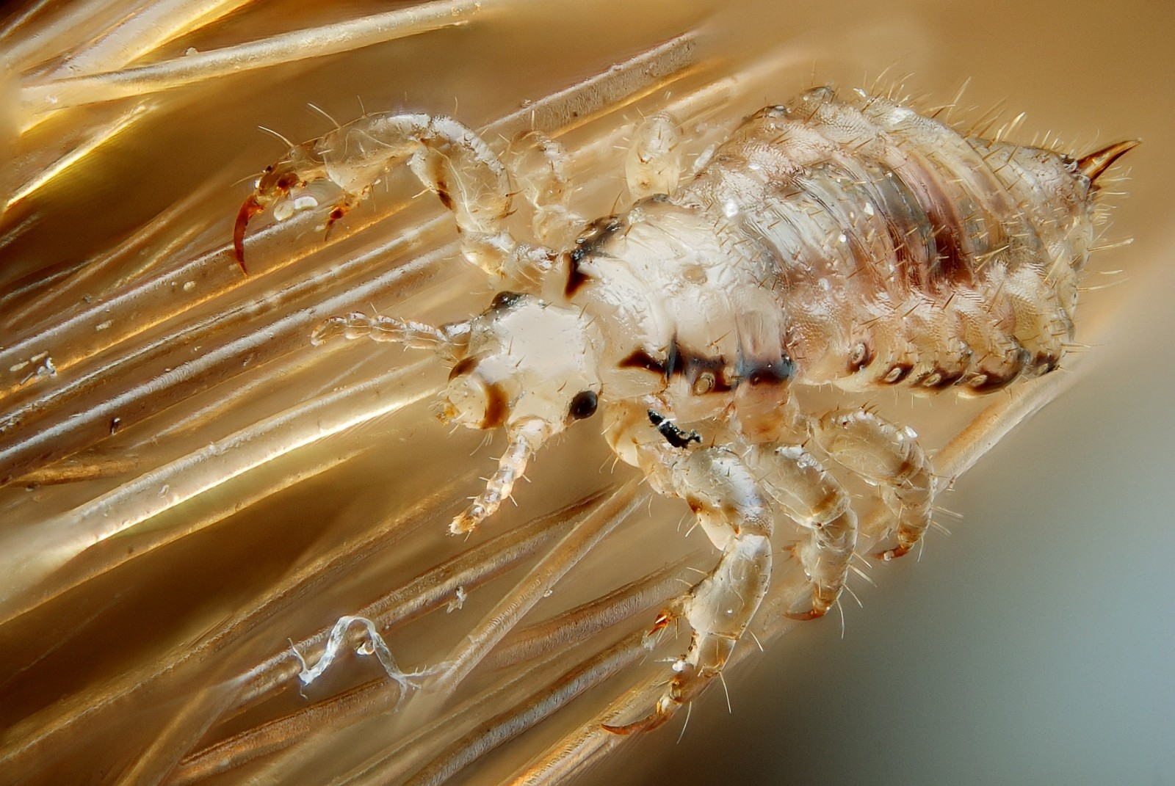
What is pediculosis capitis?
AKA Head Lice
infestation of the scalp by Pediculus humanus capitis, a common parasite in school-age children.
Adult louse lives only about 48 hours when away from a human host, and the life span of the average female is 1 month.
The female lays her eggs at night at the junction of a hair shaft and close to the skin because the eggs need a warm environment.
The eggs or nits hatch in approximately 7 to 10 days.
Itching is usually the only symptom.
Common areas involved are the occipital area, behind the ears, and the nape of the neck.

Slide 4
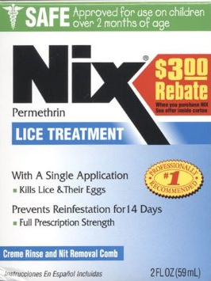
What will be your next steps in A.P.’s care?
Treat with pediculicides and manual removal of nit cases.
The drug of choice for infants and children is permethrin 1% cream rinse (Nix), which kills adult lice and nits.
Daily removal of nits from the child’s hair with a metal nit comb at least every 2 or 3 days is a control measure following lice treatment.
To ensure a cure, permethrin treatment repeated at 7-10 days after initial treatment can be done.

Slide 5
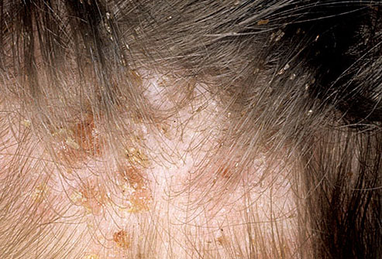
What should be included in the educational plans for A.P. and her parents?
Repeated exposure of children to strong chemicals on the scalp may be unwise
Carefully inspect children who scratch their heads more than usual for
bite marks
redness
nits
Lice are small and grayish tan, have no wings, and are visible to the naked eye.
The nits, or eggs, appear as tiny whitish oval specks adhering to the hair shaft about 6 mm (0.25 inch) from the scalp.
Do not confuse with dandruff, dandruff will fall easily

Slide 6
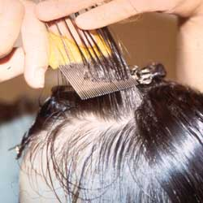
What should be included in the educational plans for A.P. and her parents?
Read the directions carefully before beginning treatment
Make child as comfortable as possible during the application process
pediculicide must remain on the scalp and hair for several minutes
Avoid open flames while pediculicide is on due to flammability
It is not necessary to remove the nits after treatment
only live lice cause infestation.
Use an extra-fine-tooth comb that is included in many commercial pediculicides or is available at community pharmacies to facilitate manual removal.
Measures must be taken to prevent further infestation such as machine-wash all clothing, towels, linens and hot dry for 20 min. Vacuum and clean the house as well to prevent further infestation.
Spraying with insecticide is not recommended because of the danger to children and animals.

Slide 7
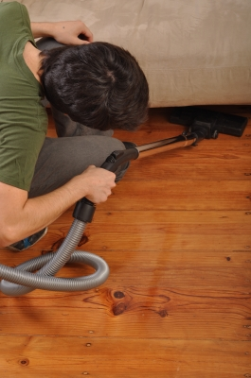
What should be included in the educational plans for A.P. and her parents?
Measures must be taken to prevent further infestation
machine-wash all clothing, towels, linens and hot dry for 20 minutes. Dry clean non-washable items.
Vacuum carpets, car seats, pillows, stuffed animals, rugs, mattresses, and furniture.
Clean the house to prevent further infestation.
Spraying with insecticide is not recommended because of the danger to children and animals.
Soak combs, brushes, and hair accessories in lice-killing products for 1 hour, or in boiling water for 10 minutes.

Slide 8
The parents take A.P. home to treat her. Which statement by A.P.’s mother would help make A.P. the most comfortable during this treatment period? Explain your answer choice
“Here is the shampoo. Be sure to scrub your head for several minutes.”
“We can pretend you are at the beauty parlor! Lean back while I wash your hair.
“I sure hope this works. I never thought this would happen!”
“It might be best to go ahead and cut your hair. It will grow back quickly.”
Answer is B because by playing beauty parlor the child lies supine with the head over a sink or basin and covers the eyes with a dry towel or washcloth. This prevents medication, which can cause chemical conjunctivitis, from splashing into the eyes. If eye irritation occurs, the eyes must be flushed well with tepid water.
Also, the child is not feeling embarrassed or uncomfortable through the process.

Slide 9
Why would head lice occur in school-aged children?
Head lice move by crawling and require direct contact with the hair of an infested person.
Usually activities such as playing on playgrounds and sports activities can increase the likelihood of head-to-head contact.
Children who share lockers are more likely to become infested
Slumber parties place children at risk.

Slide 10
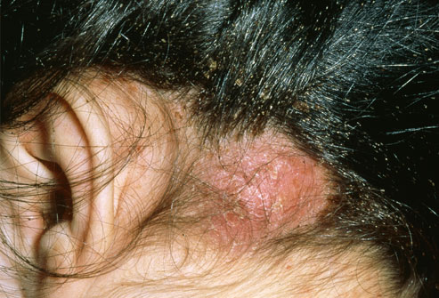
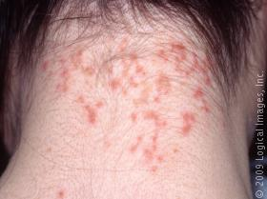
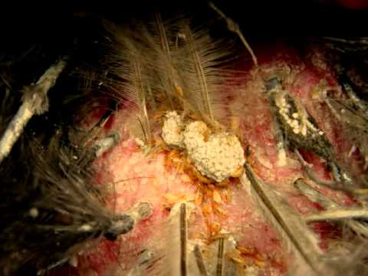
What possible complications can occur as a result of failing to treat head lice?
Sores can occur on the head from scratching.
These sores can become infected with bacteria normally found on a person’s skin.
It can also result in dry, hyperpigmented, thickly encrusted, scaly skin with residual scarring.

Slide 11
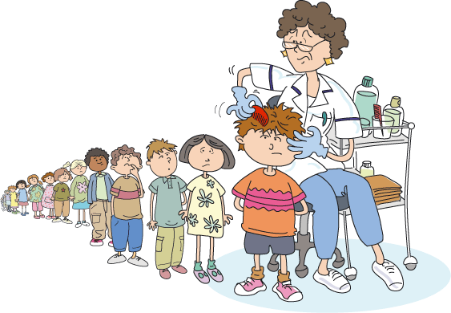
What should your nursing actions include regarding A.P.’s classmates?
EDUCATION for parents on how to check for lice!
INSPECT children at the school
TREAT infested children

Slide 12
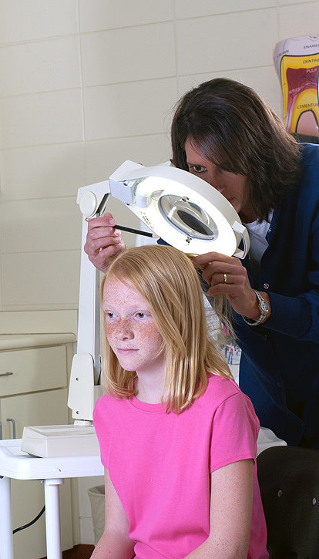
Nursing Responsibility
Live lice survive for up to 48 hours away from the host, but nits are shed into the environment and are capable of hatching in 7 to 10 days; retreatment may be required. Therefore, measures must be taken to prevent further infestation
Nurses should emphasize that anyone can get pediculosis; it has no respect for age, socioeconomic level, or cleanliness. Lice do not jump or fly, and are not carried by pets.
Nurses should carefully inspect children who scratch their heads more than usual for bit marks, redness, and nits. The hair is systematically spread with two flat-sided sticks or tongue depressors, and the scalp is observed for any movement that indicates a louse. Nurses should wear gloves when examining the hair. Children with head lice should be allowed to return to school after proper treatment.

Slide 13
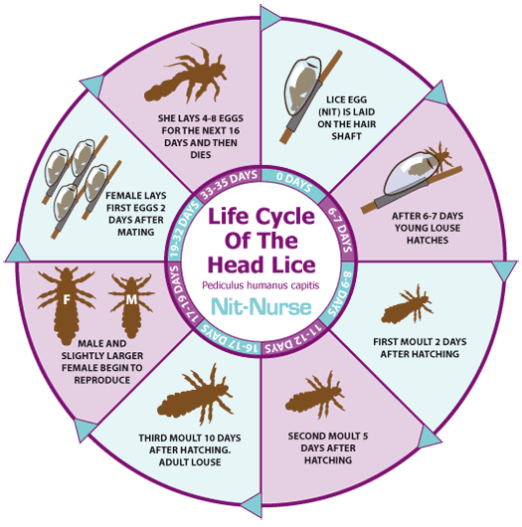
References
Center for Disease Control
(http://www.cdc.gov/parasites/lice/)
Hockenberry, M. and Wilson, D., (2013), Wong’s
Essentials of Pediatric Nursing. 9th Ed., Elsevier
Mosby.

