Slide 1
DHA in Infant Formulas
Justine Gonzalez

Slide 2
Docosahexaenoic acid (DHA)
Fatty acid found in lipid membranes of mostly the brain and eyes, other organs
Acquired through diet
Benefits
Brain development
Eye development
Prevention of neurological, cardiovascular, immunological,
and inflammatory disorders
Deficiency
Developmental impairments
Behavioral disabilities
Changes in glucose metabolism → obesity and diabetes
Abnormal visual function

Slide 3
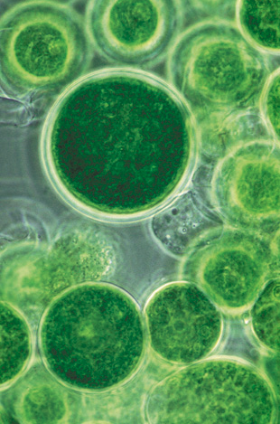
Single-celled organisms, martek, & dha
Martek Biosciences Corporation
Algae & soil fungus
DHASCO
ARASCO
Masked in infant formula
Mortierella alpine oil *(a source of arachidonic acid (ARA)
Crypthecodinium cohnii oil **(a source of docosahexaenoic acid (DHA)

Slide 4
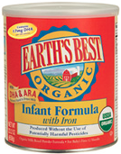
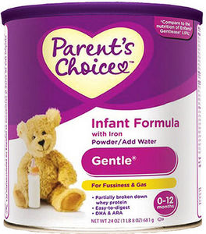
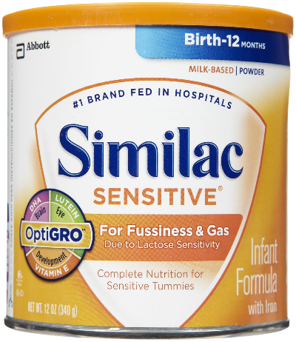
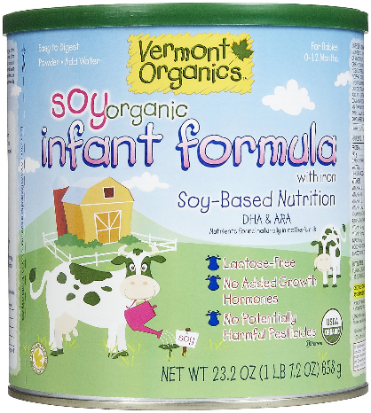
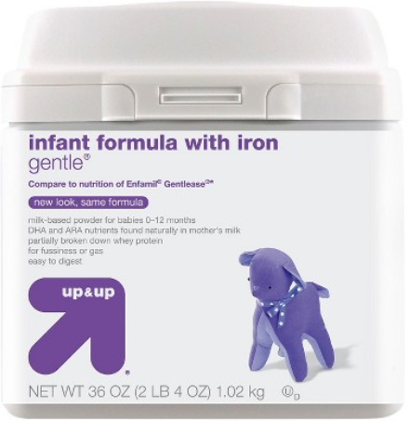
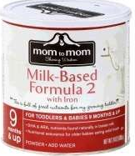
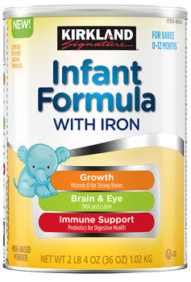
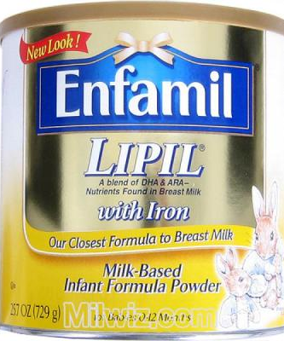
Why is this important?

Slide 5
Health issues
Formula-fed infants experience pain and discomfort
Gas and bloating
Flatulence
Reflux
Vomiting
Diarrhea
Other gastrointestinal disturbances
Hospitalizations
Unnecessary medications
Costs of care
Stress

Slide 6
Regulation
Infant Formula Act of 1980
Authorized FDA to adjust nutritional standards of infant foods to conform with science
Manufacturers must test products & report to FDA
Composition of formulas must be verified before introduced to consumer
Generally recognized as safe
Under the Federal Food, Drug, and Cosmetic Act
In use before 1958
Scientific procedures/evidence
Reasonably safe by qualified experts for its intended use
Food additives like DHASCO & ARASCO

Slide 7
Bioethical violations
Beneficense & non-maleficence | Justice | Autonomy | Veracity
Obligation to do good & to do no harm | Fairness | Ability to freely determine one’s own actions | Obligation to tell the truth and not deceive others
Deceive consumers | Martek monopolized the market | Mothers have no other choices easily available | Manufacturing practices
Harming babies | Unfair to consumers |  | Marketing

Slide 8
Position of healthcare
Support of DHA and ARA
No mention of DHASCO or ARASCO
No official stance of nursing community
Breast is best!

Slide 9
references
Camp, K. (2014). Infant formulas: What's for what and what's for whom? Walter Reed Army Medical Center Pediatric Nutritionist. Powerpoint Presentation retrieved December 2, 2014 from http://webcache.googleusercontent.com/search?q=cache:4toipgn43bUJ:www.powershow.com/view/3bad8b-NjY1Z/Infant_Formulas_What_s_for_What_and_What_s_for_Whom_powerpoint_ppt_presentation+&cd=1&hl=en&ct=clnk&gl=us&client=firefox-a
Guesnet, P. & Alessandri, J. M., (2011). Docosahexaenoic acid (DHA) and the developing central nervous system (CNS) - Implications for dietary recommendations. Biochimie, 93, pp. 7-12. doi: 10.1016/j.biochi.2010.05.005
FDA. Retrieved Nov 30, 2014 from http://www.fda.gov/Food/FoodborneIllnessContaminants/PeopleAtRisk/ucm108079.htm#3
Zhao & Encinosa (2008). Statistical brief #44: Gastroesophageal reflux disease (GERD) hospitalizations in 1998 and 2005. Healthcare Cost and Utilization Project. Retrieved Dec 9, 2014 from http://www.hcup-us.ahrq.gov/reports/statbriefs/sb44.jsp
Abramson, A. (n. d.). The Benefits of DHA & ARA. Infant Articles. Retreived December 2, 2014 from http://www.earthsbest.com/node/330
Ohm, J. (2012). What's in your baby's formula? The Outer Womb, 34. Retrieved December 2, 2014 from http://icpa4kids.org/Wellness-Articles/whats-in-your-babys-formula.html
Jennings, J. (2003). Novel Food Information: DHASCO and ARASCO as sources of docosahexaenoic acid and arachidonic acid in infant formulas. Retrieved December 10, 2014 from http://www.hc-sc.gc.ca/fn-an/gmf-agm/appro/dhasco_arasco-eng.php
The Cornucopia Institute, (2008). DHA safety and concerns. Retrieved December 2, 2014: http://www.cornucopia.org/dha-safety-concerns/
Linsert, H. (2001). Agency response letter GRAS notice no. GRN 000041. Retrieved November 22, 2014 from http://www.fda.gov/Food/IngredientsPackagingLabeling/GRAS/NoticeInventory/ucm154126.htm
Vogel, L. (2013). DHASCO/ARASCO oils: Generally recognized as safe infant formula additives. Retreived Dec 3, 2014 from http://www.dailykos.com/story/2013/02/05/1184915/-DHASCO-ARASCO-Oils-Generally-Recognized-as-Safe-Infant-Formula-Additives#
Rabbitt, M. (2014). DHA & kids: A smart supplement. Retrieved December 8, 2014 from http://www.parenting.com/article/dha-a-smart-supplement
Kraemer, D.W. (2011). Response to Cornucopia Institute’s Petition for FDA regulations of Martek-containing Infant Formulas. Retrieved December 10, 2014 from http://webcache.googleusercontent.com/search?q=cache:tjTxJlD6TgMJ:https://www.pharmamedtechbi.com/~/media/Images/Publications/Archive/The%2520Tan%2520Sheet/19/40/05111003013/111003_fda_dha_warning_petn_response.pdf+&cd=3&hl=en&ct=clnk&gl=us&client=firefox-a
Contemporary Pediatrics Staff (2011). Formula-fed infant benefit cognitively from DHA supplements. Contemporary Pediatrics, digital edition. Retrieved December 8, 2014 from http://contemporarypediatrics.modernmedicine.com/contemporary-pediatrics/content/formula-fed-infants-benefit-cognitively-dha-supplements?page=full
Organic Consumers Association, (1990). Federal organic foods production act of 1990. Retrieved December 11, 2014 from https://www.organicconsumers.org/old_articles/Organic/ofpa1990.html

