Slide 1
Adrenergic & Adrenergic-blocking Agents
GNRS 576 Pharmacology
Professor Bernal
Joyce Alexander
Janelle Bogran
Enrique Caloca
Justine Gonzalez

Slide 2
Preganglionic nerve fiber Postganglionic nerve fiber Effector cells
ACh
Nic
ACh
Mus
Parasympathetic
α
Sympathetic
ACh
Nic
NE
β
Notes:
Acetylcholine is released from
- all presynaptic
- all postganglionic parasympathetic neurons
NE
- most postganglionic sympathetic neurons
- exceptions: sweat glands (ACh) & renal arteries (dopamine)
EPI
- adrenal medulla upon sympathetic impulse
Sympathomimetics
Drugs that partially or completely mimic the actions or norepinephrine (NE) and epinephrine (Epi).
Act either - directly on α- and/or β-adrenergic receptors or indirectly on presynaptic terminals, usually by causing the release of NE.
increase plasma glucose, inc HR, inc BP, inc metabolic function, dec GI/GU function
Sympatholytics
inhibition or blocking of the receptors, so we don’t get the affects of the nxm binding
dec CO, dec renin release, inhibition of glycogenolysis and glu release in response to hypoglycemia
in bronchial airway resitance
beta blockers: HTN, angina, migraine, CHF
Parasympathomimetics
DIRECT = mimic ACh
INDIRECT = inhibits Ach-esterase
lowering heart rate, contraction of ciliary muscle in eye, inc secretions, inc GI/GU function
Parasympatholytics
M-BLOCKERS = inhibit bronchial/gastric secretions, relax smooth muscle, increase HR
N-BLOCKERS = skeletal muscle relaxants
http://pharmacologycorner.com/acetylcholine-receptors-muscarinic-and-nicotinic/

Slide 3
Notes:
http://pharmacologycorner.com/acetylcholine-receptors-muscarinic-and-nicotinic/

Slide 4
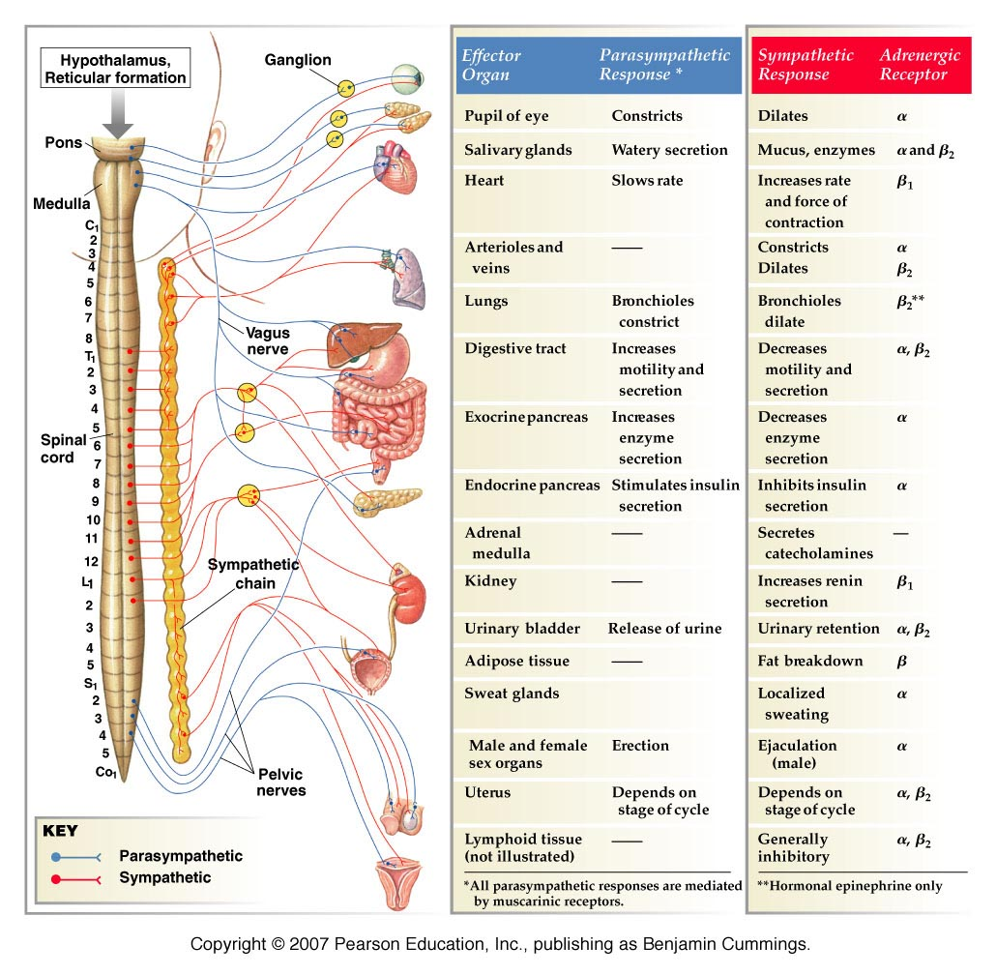
Notes:
Alpha 1—smooth muscle contraction
Alpha 2-negative feedback causes less norepinephrine to be released so BP is reduced
Beta 1—increased heart rate
Beta 2—bronchodilation
Muscarinic – smooth mucle constriction and vasodilation
Nicotinic – skeletal muscle contraction
Sympathomimetics – act like parsympatholytics
dilate pupils, inc HR, inhibits vasodilation, bronchodilation, dec secretions
Sympatholytics – act like parasympathomimetics
inc secretions, dec HR, inc GI motility, vasodilation = dec BP, improve urine flow, relax sm muscles
you can get postural hypotension, Na/H2O retention, nasal stuffiness, miosis, sexual dysfunction

Slide 5
Activation Responses
Response | Alpha 1 | Alpha 2 | Beta 1 | Beta 2 | Nicotinic | Muscarinic
Constriction | Blood vessels, bladder and prostate capsule |  | Release of renin causes vasoconstriction and elevated BP | Skeletal muscle | Skeletal muscle | Smooth muscle in bronchiole and GI tract, pupils
Dilation | Pupils |  |  | Bronchodilator, vasodilatation (opposite of alpha 1), and relaxation of uterus |  | Blood vessels
Inhibits |  | Release of Norepin-ephrine |  |  |  | Slows heart rate
Stimulates | ejaculation |  | Increases heart rate and force of contraction. release of renin. | Glycogenolysis (breakdown of glycogen to glucose) | Release of epinephrine | Glandular secretion

Slide 6
Alpha-1 & Alpha-2 Agonists
Phenylephrine (Sudafed PE)
Clonidine (Catapres)
Strong stimulating action on the cardiac alpha-1 receptors
Decongestion, elevation of BP, and pupil dilation
Hypertension, prostatic hyperplasia, and hyperemia
Activation of alpha-2 receptors in the CNS (brainstem)
Vasodilation, decreased BP, treating severe pain
Drowsiness, bradycardia, Xerostomia, and rebound Hypertension

Slide 7
Alpha-1 & Alpha-2 Blockers
Prazosin (Minipress)
Phentolamine
Produces selective blockade of A-1 receptors.
Dilation of arterioles, relaxation of the trigone, sphincter, and prostatic capsule.
Orthostatic Hypotension, reflex tachycardia, nasal congestion, and inhibition of ejaculation.
Competitively blocks A-2 receptors
Treats pheochromocytoma, prevent tissue necrosis & reversal of soft tissue anesthesia
Orthostatic hypotesion, nasal congestion, & inhibition of ejaculation

Slide 9
Beta-1 & Beta-2 Agonist
Dobutamine
Albuterol (Proventil)
Stimulates myocardiac beta-1 receptors
Used to treat HF
Tachycardia
Binds to Beta-2 receptors in airway smooth muscle.
Bronchodilation
Palpitations, tachycardia, tremors

Slide 10
Beta-1 & Beta-2 Blockers
Metoprolol
Blocks stimulation of cardiac Beta-1 receptors
Reduces HR, force of conduction, & conduction velocity through the AV node.
Bradycardia, reduced CO, AV heart block, and rebound cardiac excitation following abrupt withdrawal.

Slide 11
Muscarinic Agonist/Antagonist
Bethanechol
Atropine
Reversibly binds to muscarinic cholinergic receptors.
Drug only approved for urinary retention
Hypotension & Bradycardia
Produces effects through competitive blockade at muscarinic receptors
Increases HR, decreases secretions
Xerostomia, blurred vision, & urinary retention

Slide 12
Role of the Nurse
As patients receive any type of autonomic drug the nurse must:
1. Assess the patient’s condition carefully
2. Provide education about drug treatment
3. Use teach back methods to ensure
patient understood
4. Identify any contraindications
5. Monitor for any adverse effects

Slide 13
Administering Adrenergic Agents
As a nurse, be aware of receptors and their functions!
Ex: Patient is receiving an Alpha 1 adrenergic agent
* Receptors are located in the eyes, blood vessels, male sex organs, prostatic capsule, and bladder (trigone and sphincter)*
*Function: constricts blood vessels and dilates pupils

Slide 14
Nurse’s Role & Adrenergic Agents
It is the Nurse’s responsibility to:
Closely monitor IV insertion sites for extravasation with IV administration
Monitor breathing patterns, SOB, and/or audible wheezing
Observe patient’s responsiveness to light
Monitor for rhinorrhea and epistaxis

Slide 15
Administering Adrenergic Blocking Agents
Ex: Patient is receiving an Alpha adrenergic blocking agent
*Function: prevent receptor activation by epinephrine. Can be used to treat toxicity (eg, hypertension, local vasoconstriction) caused by excessive epinephrine-induced alpha activation.

Slide 16
Nurse’s Role & Adrenergic Blocking Agents
It is the Nurse’s responsibility to:
Monitor urinary hesitancy/feeling of incomplete bladder emptying, interrupted urinary stream
Monitor for syncope
Monitor vital signs, LOC and mood changes
Monitor for dizziness or drowsiness
Observe for side effects: blurred vision, tinnitus, epistaxis, and edema
Monitor liver function

Slide 17
References
Lehne, R. A. (2013). Pharmacology for Nursing Care, 8th Edition [VitalSource Bookshelf version]. Retrieved from http://pageburstls.elsevier.com/books/978-1-4377-3582-6
http://pharmacologycorner.com/acetylcholine-receptors-muscarinic-and-nicotinic/
Silverthorne, A. C. (2004). Human Physiology, 3rd Edition: San Francisco, CA.
Vallerand, A. H., Sanoski, C. A., & Deglin, J. H. (2013). Davis's drug guide for nurses. Philadelphia, F. A. Davis Co.

